Slide 1
AI-Assisted Game Mashups
By: Zidian, Jackie, B

Slide 2
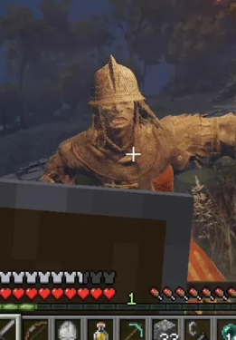

What Is a Game Mashup?
A game mashup combines elements, gameplay from two different games, allowing player using one's mechanic in another.

Slide 3
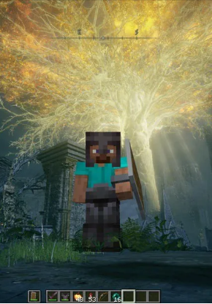
Example: Minecraft & Elden Ring
This starts to getting popluar recently when people found out you can use claude to backwarding old games, they realized they can merge two game together, so here it is Minecraft Ring, Tobny Jacobs under the help of claude, he made minecraft into an elden ring mod, the gameplay of minecraft into Elden ring's boss fight.
https://x.com/i/trending/2104964358027542770?lang=en

Slide 4
How does it work?
The most common way is: The Bridge Method
Two original games run simultaneously in the background on your PC while communicating through shared memory to sync player positions, physics, and world hits. (This is how Minecraft run inside Elden ring)
It's doesn't has to be an AI to write the code in this way, buy AI is more efficient than human when it comes to "well known" ideas.

Slide 5
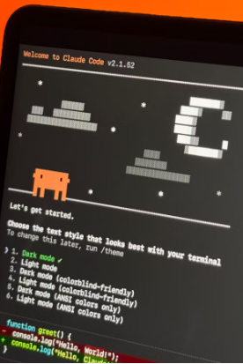
Why does it matter?
AI vibe coding may help small teams to be more efficient not just mashup games.
Mashups can offer a way to experiment with new gameplay ideas.
Compatibility and testing remain major challenges, But this can be reduced alot when AI steps in to help debugging

